Slide 1

More than you wanted to know about
Robot Winch Design
David Giandomenico
Lynbrook High School Robotics
FIRST Team #846
DGiandomenico@lynbrookrobotics.com
(408)343-1183

Slide 2
A few common tasks robots might do:
Robot may move itself
Robot often has an arm to lift or grasp objects
Robot might have to lift itself or pull an object

Slide 3
Three functions we may consider:
Design a robot arm
Design the drive train
Design a lifting winch
We will consider the winch, which is arguably the most simply specified of the three robotic functions.

Slide 4
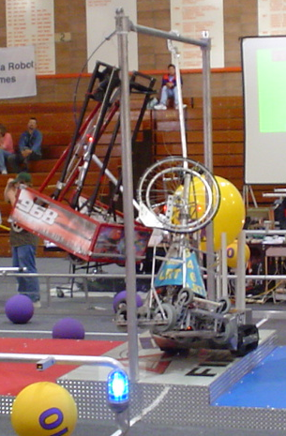
2004 FIRST National Robotics Competition
Endgame Task: Robot must suspend itself from a bar located 10 feet above the floor
Our task: Design a winch to lift robot

Slide 5
Design Criterion for the Winch
How much weight to lift?
How far?
How fast?

Slide 6
What We Want.
Weight:
Distance:
Time (speed):
130 lbs
1.5 feet
5 seconds

Slide 7
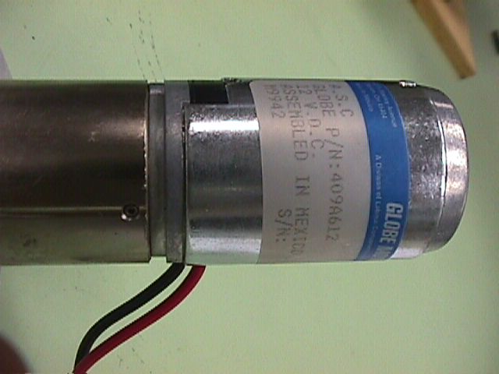
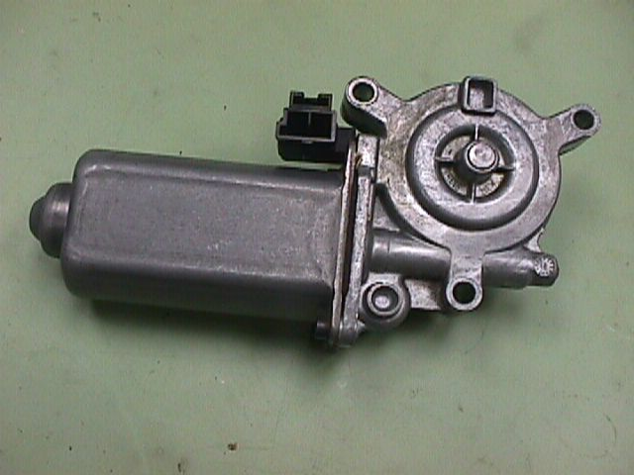
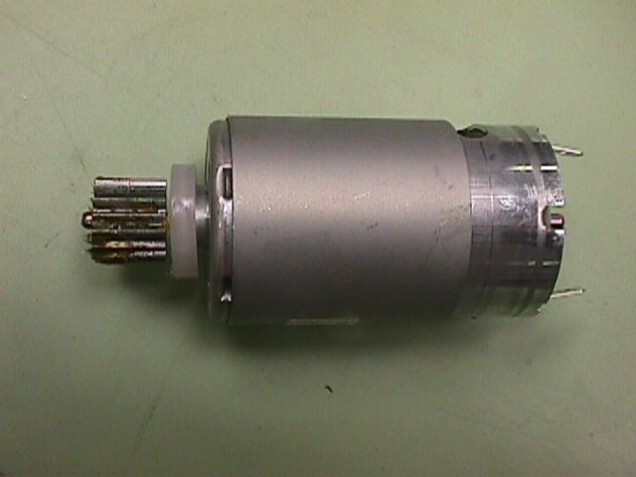
What we have:
(Some of the Motors supplied in FIRST Robotics Kit)

Slide 8
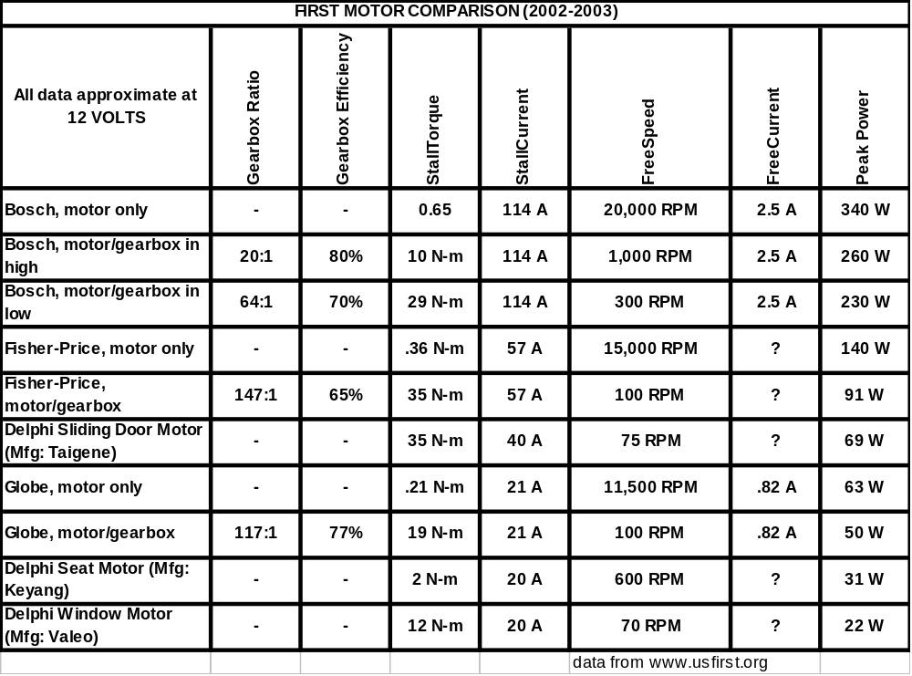

Slide 9
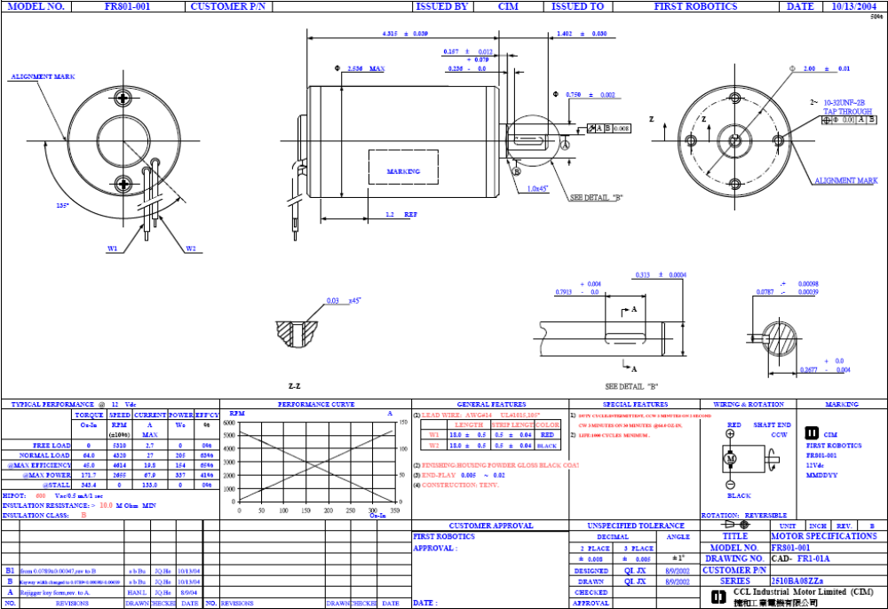
“CIM” Motor Specification

Slide 10
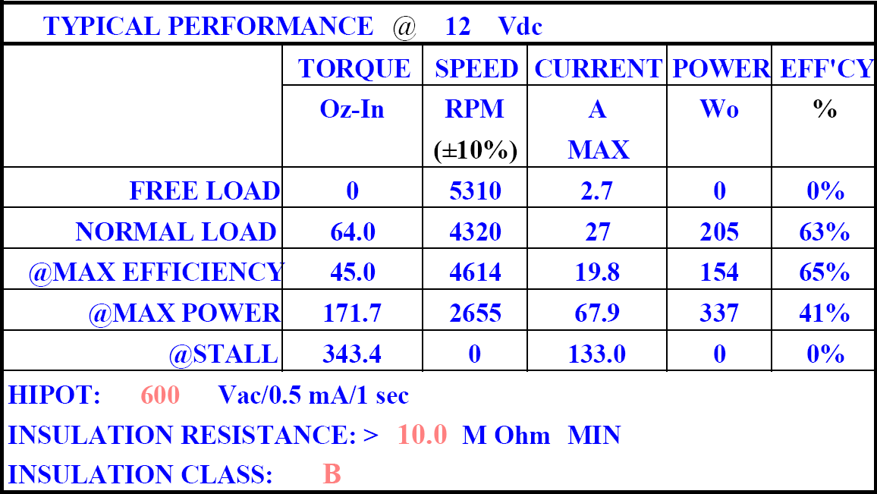
“CIM” Motor Performance

Slide 11
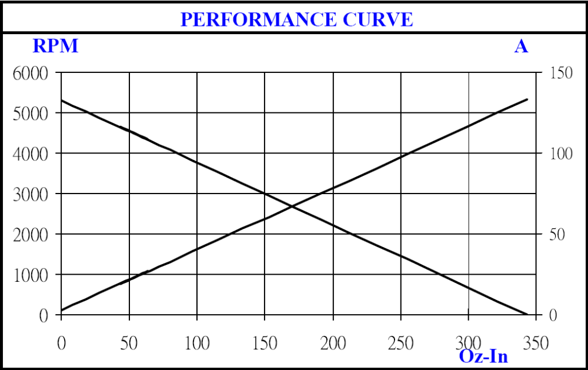
“CIM” Motor Performance

Slide 12
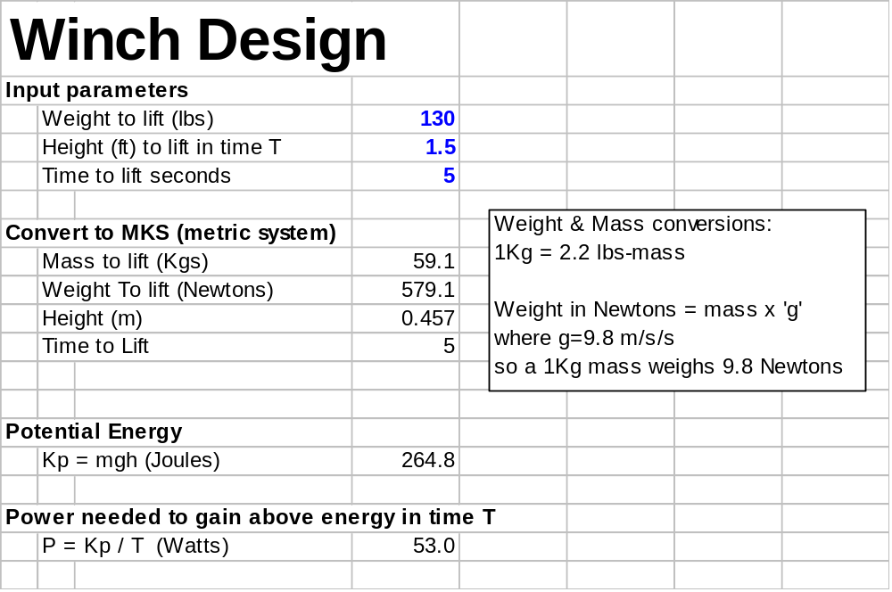

Slide 14
Choosing a motor based on
Maximum Motor Output Power
The max power of a DC PM magnet motor cannot be sustained without burning out the motor!
As a rule of thumb, operate motor at 70%-80% of the
no-load speed.
Power output = P_{max} * 4α(1-α)
where α ≡ % no-load speed
Coincidentally,
At 75% no-load speed, P_{out} = 75% P_{max}
Need to consider losses in Gear sets

Slide 16
Estimate gear loss for a large gear reduction
Consider a large gear reduction of 1200
First, estimate number of small gears sets (Typical gear sets might have a ratio of 3:1)
Second, estimate the loss in for n gear sets

Slide 17
Gear loss estimate for a set of gears
Suppose we have n=3 inline sets of gears, each with a 4:1reduction. What is the total efficiency if each gear set loses 4%?
η_{T} = η_{i}^{n}
or
η_{T} = (100%-4%)³ = 88.5%

Slide 18
Estimate of how many gears to make a large gear reduction.
Suppose we want a gear reduction of 1200. How many gear sets with a reduction of 3 do we need?
Solve 3^{N} = 1200
N = ln(1200)/ln(3) = 6.45
In the final design, N must be an integer, but for the interim design, this method conveniently allows us to estimate the loss without committing to a specific gear selection.

Slide 19
Gear loss estimate
From before, we need around n=6.45 gear sets. Assuming a loss of 4% for each gear set,
η_{T} = η_{i}^{n}
or
η_{T} = (1-4%)^{6.45} = 76.8%

Slide 20
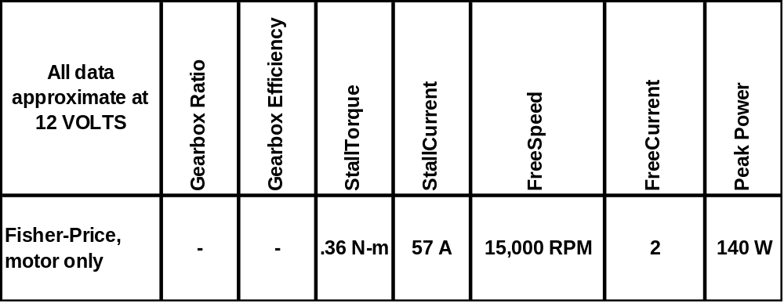
Fisher Price Motor Data 2004

Slide 21
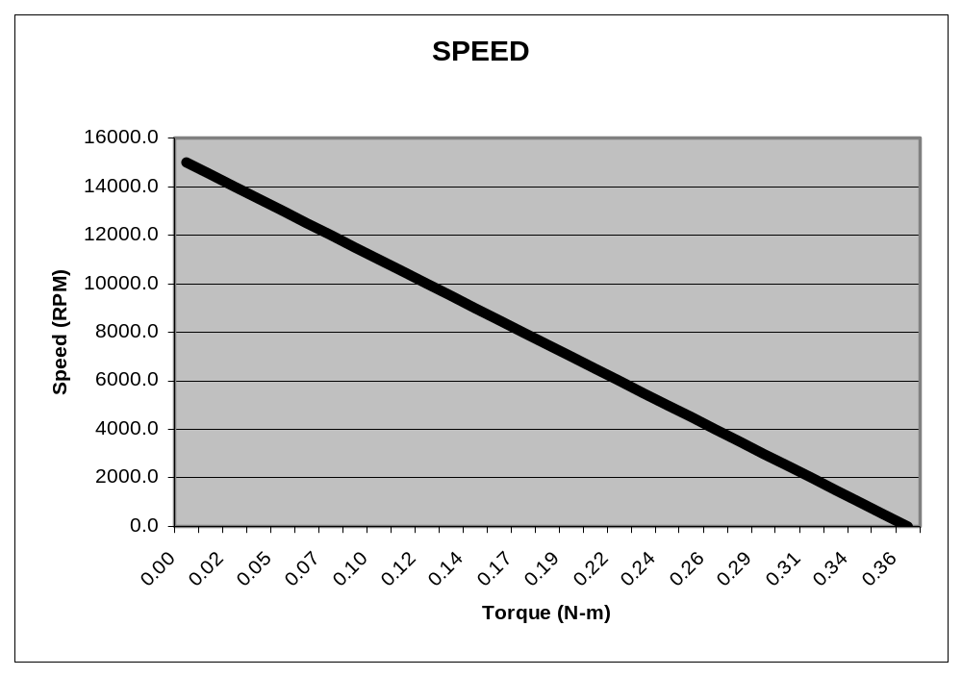
Fisher Price Motor 2004
V=12VDC
Speed decreases as motor is braked
From FIRST_MOTOR_CALC.xls

Slide 22
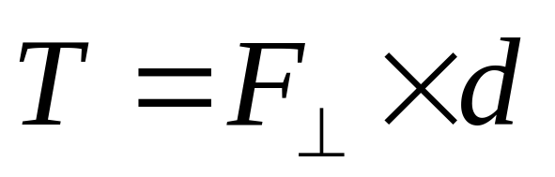
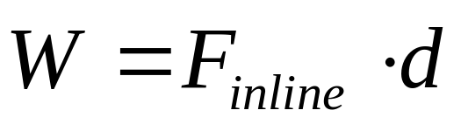
What is Torque?
But isn’t that “Work”

Slide 23
Units of Work vs. Torque
Work (Energy)
Torque
ft-lbf, Joules (=N-m), KWh, etc.
pound feet(lbf-ft), ft-lbf, oz-in, N-m etc.

Slide 24


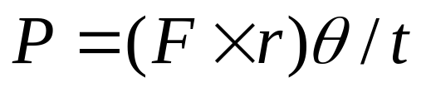
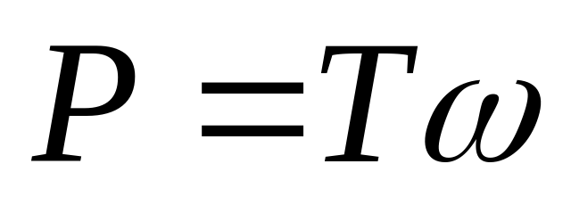
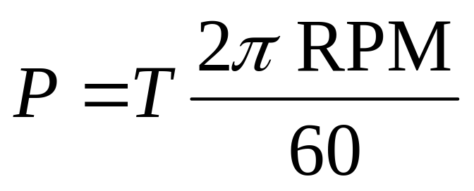
Power, Torque & Speed

Slide 25
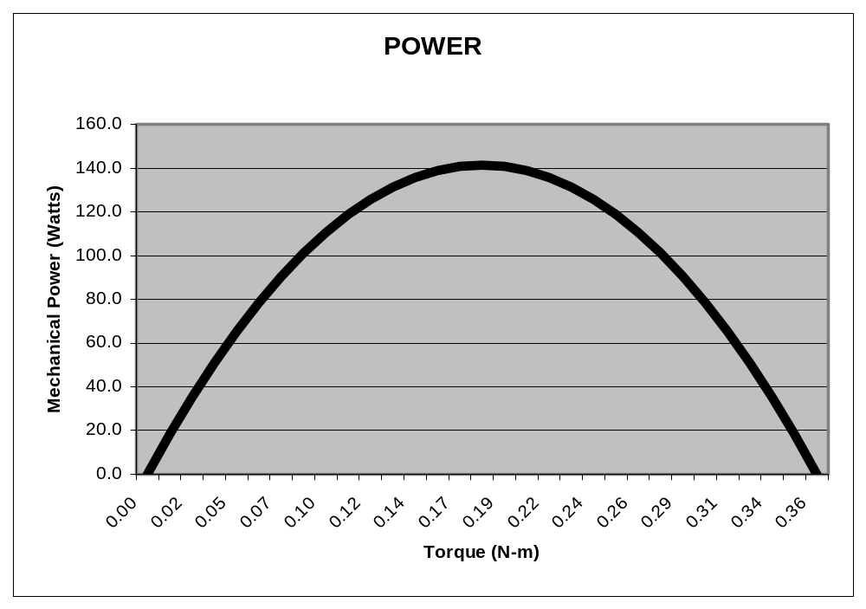
Fisher Price Motor 2004
V=12VDC
From FIRST_MOTOR_CALC.xls

Slide 26
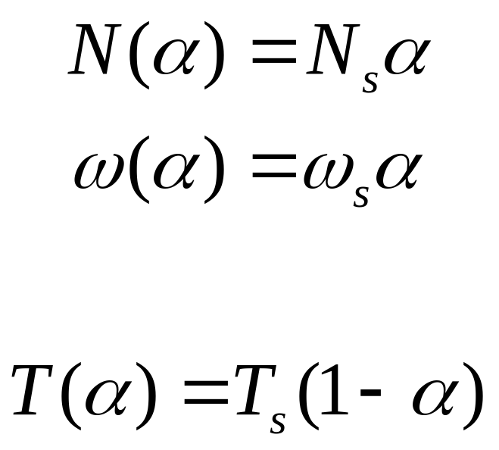
Speed & Torque in a DC PM Motor
Let α={0,100%}
such that

Slide 27
Fisher Price Motor 2004
V=12VDC
From FIRST_MOTOR_CALC.xls

Slide 28
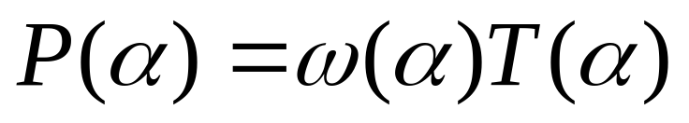
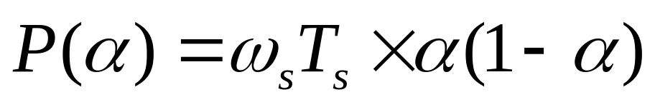
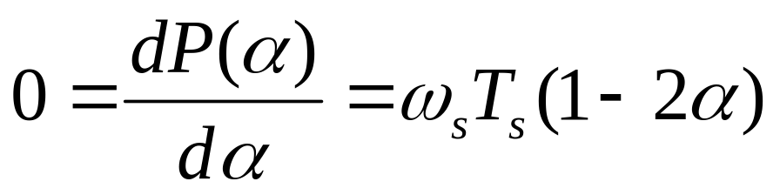
Speed & Torque in a DC PM Motor
Using calculus, Max Power occurs when:
Or, w/o calculus, Max occurs between two roots of quadratic, at α=0, α=1 that is,
α=½ or equivalently, when α=50%

Slide 29
Fisher Price Motor 2004
V=12VDC
From FIRST_MOTOR_CALC.xls

Slide 30
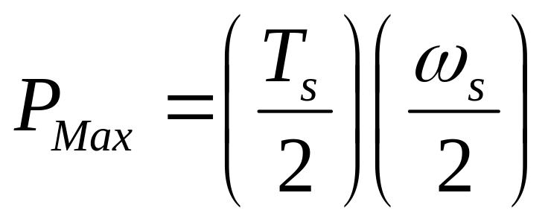
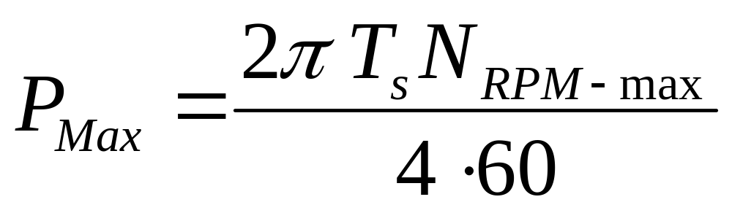
Max Power in a DC PM Motor

Slide 31
Fisher Price Motor Data 2004

Slide 32
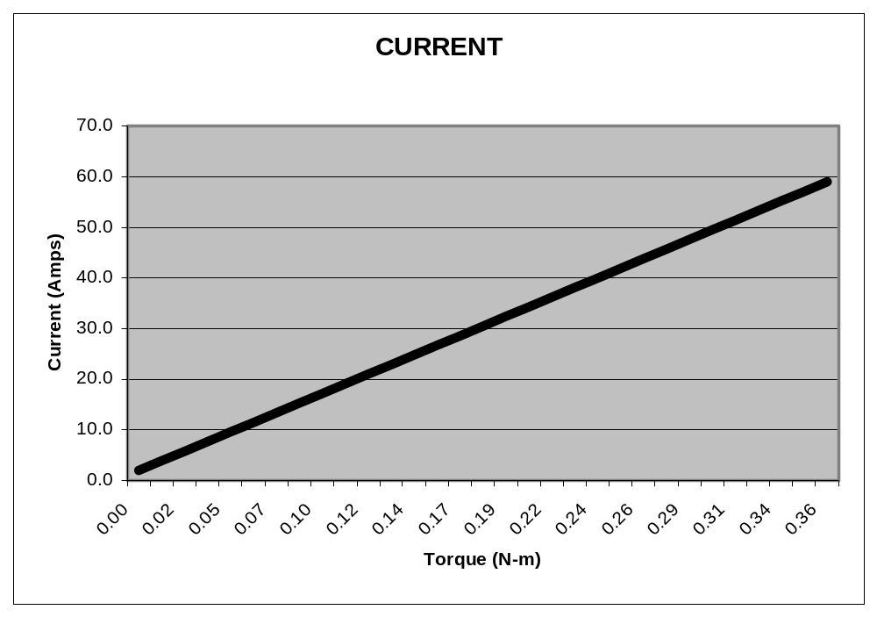
Fisher Price Motor 2004
V=12VDC
From FIRST_MOTOR_CALC.xls

Slide 33
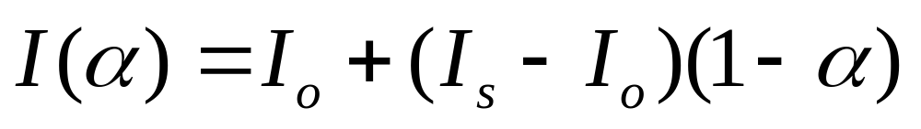
Power input into a DC PM Motor
Device Under Test (DUT) conditions:
V = 12VDC (fixed)
Load is varied using some type of brake
Under these conditions, a good model for the current is:

Slide 34
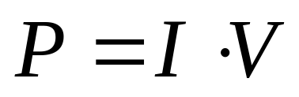
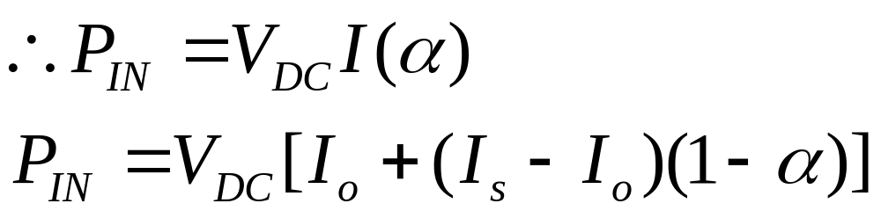
Power input into a DC PM Motor
Power is small when α=100%, and increases linearly as α decreases

Slide 35
Fisher Price Motor 2004
V=12VDC
From FIRST_MOTOR_CALC.xls

Slide 36
Fisher Price Motor 2004
V=12VDC
From FIRST_MOTOR_CALC.xls

Slide 37
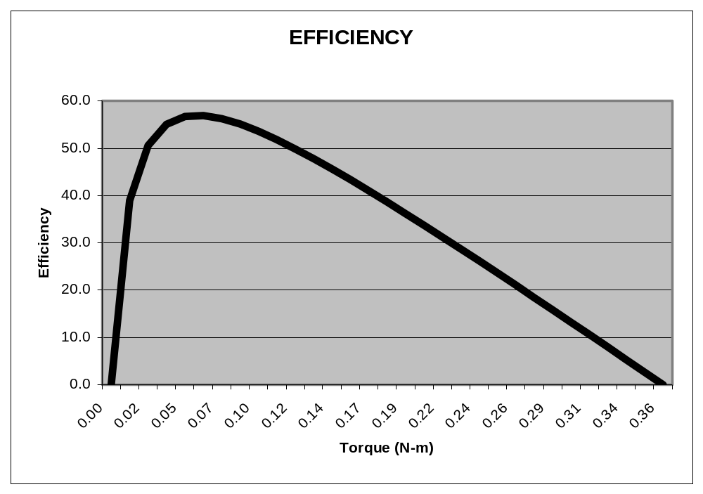
Fisher Price Motor 2004
V=12VDC
From FIRST_MOTOR_CALC.xls

Slide 38
DC PM Motor Summary
Max Power occurs at 50% No-Load Speed
Best efficiency typically occurs at about 75%-85% No-Load Speed
Most DC PM Motors cannot sustain operating with full voltage applied at speeds less than 50% No-Load.

Slide 39
Putting it all together
Choose a winch drum size
Calculate the drum rpm
Choose the % motor operating speed
Calculate the required gear reduction to operate at that speed
Verify the output winch line force meets or exceeds the original specification, including gear box losses

Slide 40
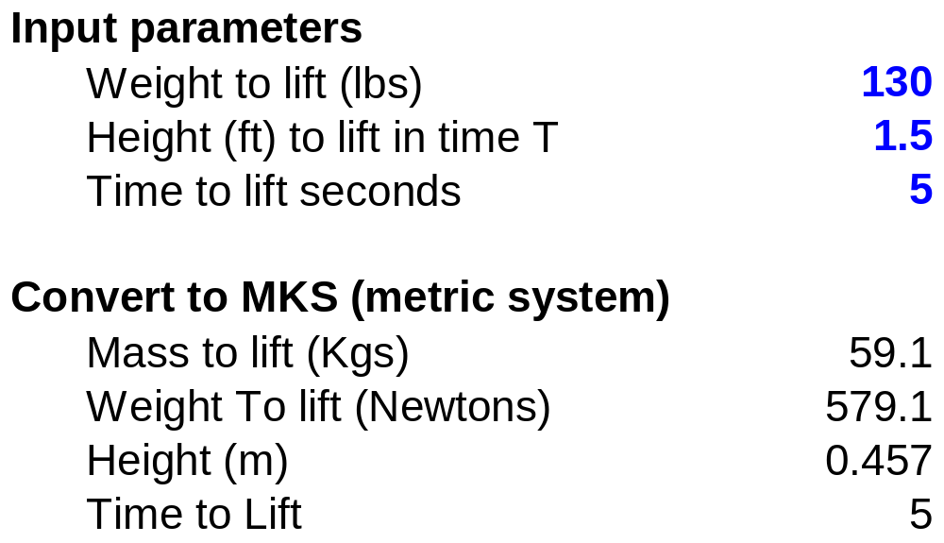
Winch Design Specification

Slide 41
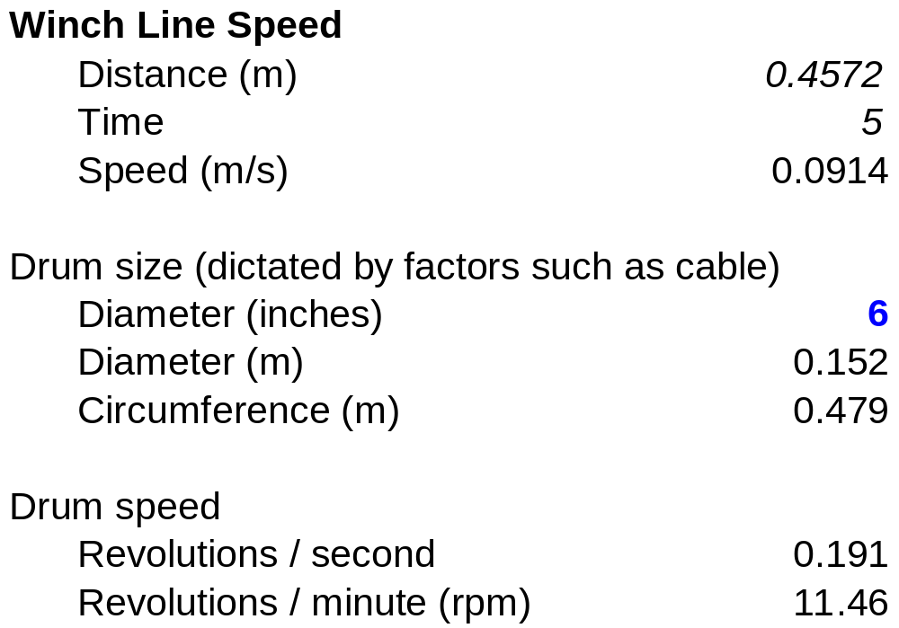
Winch Drum Speed

Slide 42
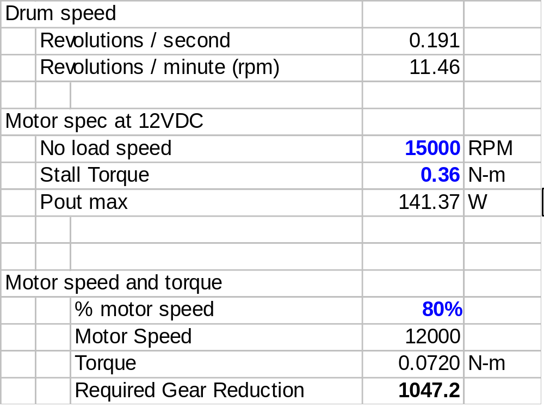
Determine the Gear Reduction

Slide 43
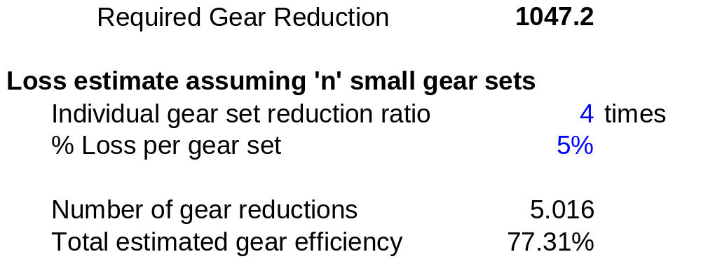
Gear Loss Estimate

Slide 44
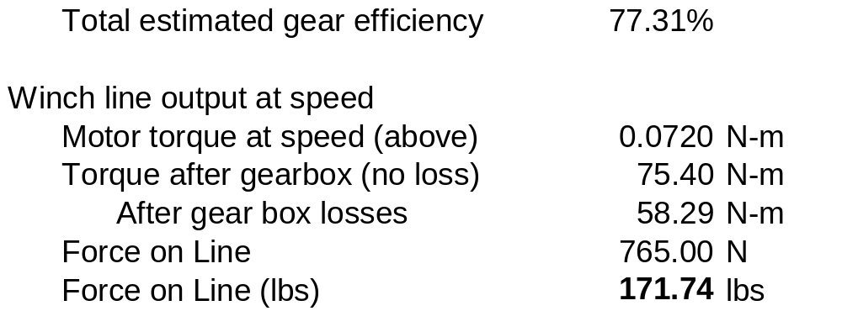
Verify We Meet or Exceed Pull Strength Specification

Slide 45
Feat Accomplished!
171lb exceeds required spec of 130lbs
What does this mean?
Things to think about:
  Could it be that we overdesigned the winch?
  How will the winch respond when lifting 130lbs if it is pulling with 171lbs?
  And of course, how do we build this winch?

Slide 46
More than you wanted to know about
Robot Winch Design
David Giandomenico
Lynbrook High School Robotics
FIRST Team #846
DGiandomenico@lynbrookrobotics.com
(408)343-1183

